Slide 1
Node-RED: How to Build an IoT-connector in 10 Minutes

Slide 2

Casper Lans
Advanced Software Engineer
casper.lans@zuehlke.com

Slide 3
Disclaimer
No testing
No device provisioning
No security
Quick & dirty

Slide 4
Node-RED
Flow-based programming for the Internet of Things
Browser-based editor

Slide 5
Node-RED
Built on Node.js
Event-driven, non-blocking, single-threaded
Light-weight runtime
Runs on low-cost hardware & in the cloud

Slide 6
Node-RED
Platforms
Local
npm install node-red
Docker
On a device
Raspberry Pi
BeagleBone Black
Arduino
Android (“a bit experimental”)
In the cloud
IBM Cloud
SenseTecnic FRED
Amazon Web Services
Microsoft Azure

Slide 7
Node-RED
Nodes are the building blocks
Good set of basic nodes for different protocols and logic
Lots more nodes available as NPM packages
Easy to develop your own nodes

Slide 8
Node-RED
Who created it?
Initial development by IBM
First release in 2013
Donated to the OpenJS Foundation in 2016
Lead developers still IBM employees
Latest version: v0.20.7
v1 expected soon

Slide 9

Use Case: As a Fleet Manager, monitor a fleet of vehicles

Slide 10

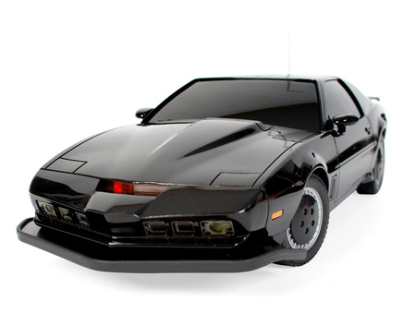




Internet of Things
Architectural
Diagram
MQTT
HTTP
Azure IoT Central
Notes:
What is wrong with this picture?
KITT (aka Knight Industries Two Thousand) was the first Level 4 Autonomous Vehicle, fully connected, driven by AI

Slide 11
Architectural Diagram
Sensor
Node-RED
IoT Central
HTTP
MQTT
Raspberry Pi

Slide 12

Demo

Slide 13
Should you use it?
Prototyping: definitely
Production: it depends…
Do you allow users to modify flows?
If so, how do you install updates?
Performance?
How complex is your business logic?
Pretty stable: but exception in one node crashes Node-RED completely
Azure IoT Hub node not production ready!

Slide 14
Visual programming has it’s limitations
“The flow chart is a very poor abstraction of software structure” -- Fred Brooks, No Silver Bullet
Flow chart visualises only one aspect of the program; what about state or control flow?
“Code” reuse and encapsulation is difficult
Separation of concerns is difficult
Flow quickly outgrows your screen
Only one flow can run at a time
Merge conflicts of auto-generated flow files (JSON)

Slide 15
Debugging
Only possible with logging messages (debug node)
JavaScript in function nodes can also only be debugged with console.log()
But if you have developed your own node, you can attach a debugger to it
Pattern: if your function node becomes so complex that you need to debug it, convert it into a custom node

Slide 16
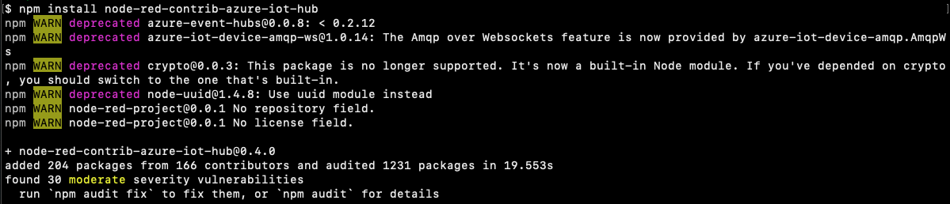
NPM
Got a problem? Somebody already solved it
Quality?
Security?
Maintained?
OS licenses?

Slide 17
Tools
Test nodes and flows with Mocha
TypeScript
Lerna (monorepo)
VS Code
C++ bindings with NAN (Native Abstractions for Node.js)
C# bindings with Edge.js
OPC UA with node-opcua

Slide 18
Questions?

Slide 19
Sensor
Yocto-3D-V2
Accelerometer
Gyroscope
Compass
USB connection
~ € 50
C++
C#
Java
JS
HTTP and many more

Slide 20
Raspberry Pi
Small single-board computer
To promote teaching of basic computer science in schools and in developing countries
Does not include peripherals
Lots of OS images available
Raspbian is the official OS
~ € 35 - 60

Slide 21
Node.js
Cross-platform JavaScript runtime
Server-side (no browser)
Asynchronous (non-blocking)
Single-threaded
Designed to build scalable network applications

Slide 22
MS Azure IoT Central
Easily connect, monitor and manage your IoT assets at scale
Software as a Service (SaaS)

